Slide 1
DriveInfo Class
Represented By
Digvijay Rajurkar

Slide 2
DriveInfo Class
Computers often have several drives. On Windows, these use letters such as C or D as names.
In the .NET Framework, the DriveInfo class provides helper methods for checking these drives. We can get all drives.

Slide 3
DriveInfo Constructor
DriveInfo Methods
DriveInfo Properties

Slide 4
DriveInfo Constructor
Provides access to information on the specified drive.
Namespace: System.IO
Assembly: mscorlib (in mscorlib.dll)
Syntax:
public DriveInfo (
string driveName
)

Slide 5
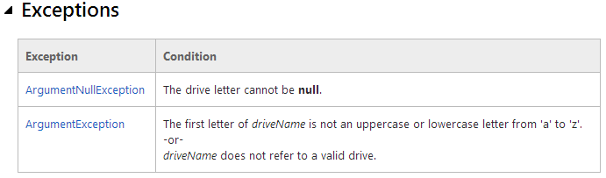
Exceptions

Slide 6
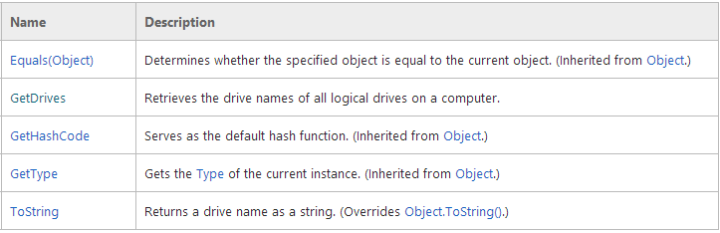
DriveInfo Methods

Slide 7

Explicit Interface Implementations

Slide 8
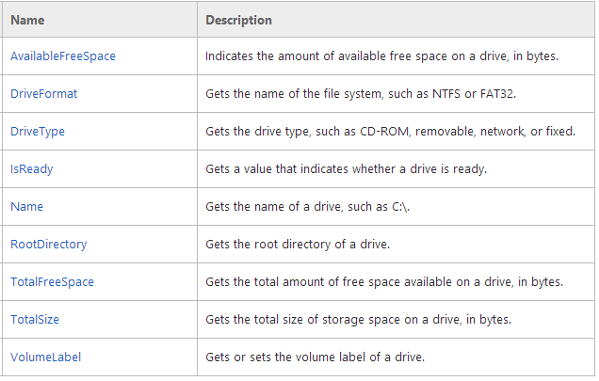
DriveInfo Class Properties

Slide 9
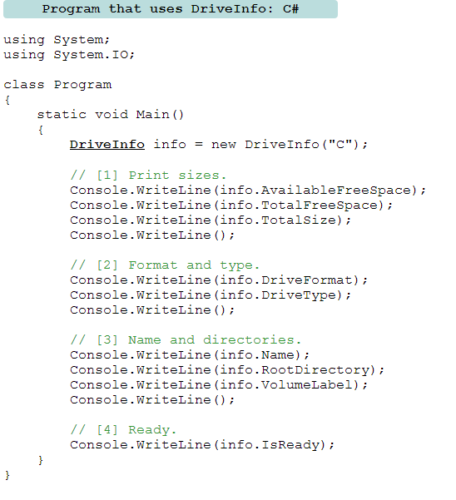
.
Example:

Slide 10
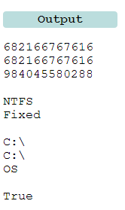
.

Slide 11
Thank You...

